Slide 1
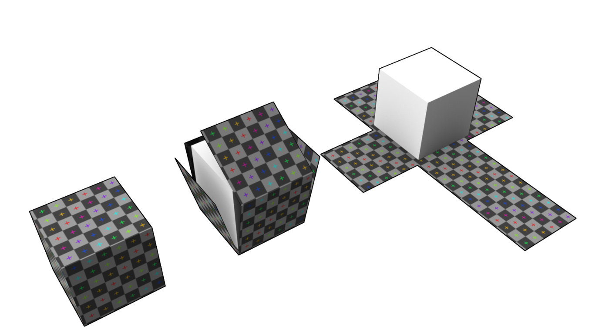
Character Development
Week 5 | Semester 1 2023
Ian Bell | ian.bell@smtafe.wa.edu.au

Slide 2
Scrums
Progress on AT01/AT02 for character dev
Share examples of character designs & prototypes
3 things you’ve had trouble with so far
3 things you are happy with
3 things you’d like to improve

Slide 3
Last Week
UV unwrapping
PBR textures – normal, albedo, height, metallic
Retopology theory

Slide 4
This week
Tutorial: Fast ‘Cartoon’ character modelling
Blender Shaders & Lighting
Retopology recap + activity

Slide 5
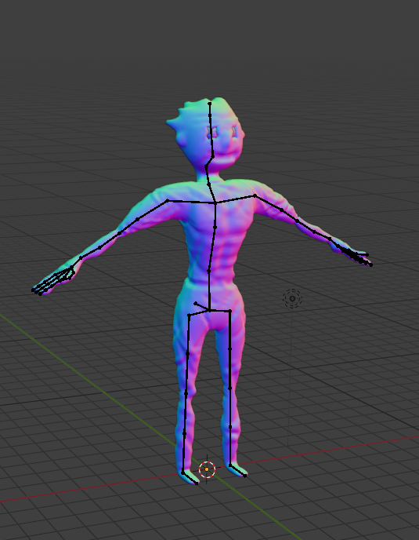
Fast ‘Cartoon’ Character – La Creatura
Good for prototyping & stylized characters
Good for monsters/organic modelling
Topology will be bad & probably require retopology before use
Notes:
Demonstrate how to make ‘La Creatura’ in terms of basics
Mirror Modifier first
Skin modifier
Subdivision
Ctrl+A to scale
Reset root object so scaling of feet/others works
Ctrl+shift+B to bevel different vertices
Skin modifier has ‘create armature’ option

Slide 6
Steps for Making Character with Skin Modifier
Start with cube
In edit mode hit S + zero with all vertices selected to shrink them to centre
Hit M then select ‘Merge at Centre’
Add (in this order) Mirror mod, skin mod, subdivision mod
Set ‘Merge’ in Mirror modifier to 0.1
Use extrude & grab on vertices to lay out ‘stick figure’ while in front view
Ctrl+A to add ‘thickness’ to vertices
Ctrl+Shift+B to ‘bevel’ vertices
Ctrl+R to add in vertices with loop cut
Make sure to save backup before applying any modifiers

Slide 7
Skin Modifier Character - Extras
Vertices and edges can be turned into a simple armature
On the skin modifier hit the ‘Create Armature’ button

Slide 8
Shaders & Basic Lighting
Default shader in Blender is Principled BSDF (Bidirectional Scattering Distribution Function)
Based on the Disney Principled model aka PBR shader
Works in Blender with a node-based system to ‘plug in’ different types of modifiers and calculations
Can be used with image textures or for procedurally generated shading

Slide 9
Shaders & Basic Lighting
Blender’s ‘Light’ object
Five different types: Sun, Point, Area, Hemi, Spot
Each type suits different applications/use cases
Settings within each type can be adjusted based on circumstance
Mostly useful for rendering animations/scenes within Blender
Objects for use in games will be lit by the game engine’s own lighting system

Slide 10
Retopology – Revision & Practice
Taking high-resolution mesh & creating a low-resolution/low poly version
Details from high-resolution mesh are ‘baked’ into normal map
This method saves on resources in game engines
Retopology is also used in the creation of ‘LOD’ (Level of Detail) models
Low-resolution versions of models are swapped out for high-resolution versions as the player gets closer

Slide 11
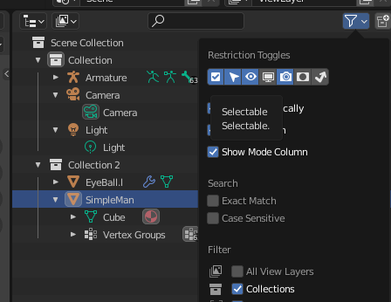
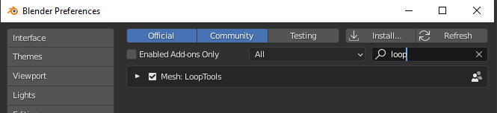
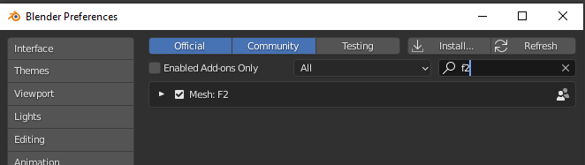
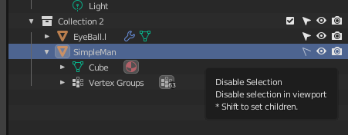
Blender Retopology - Setup
Blender Preferences -> Addons
LoopTools enabled
F2 enabled
Restriction toggles -> selectable
Set ‘SimpleMan’ to non-selectable

Slide 12
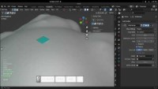
Blender Retopology - Basics

Slide 13
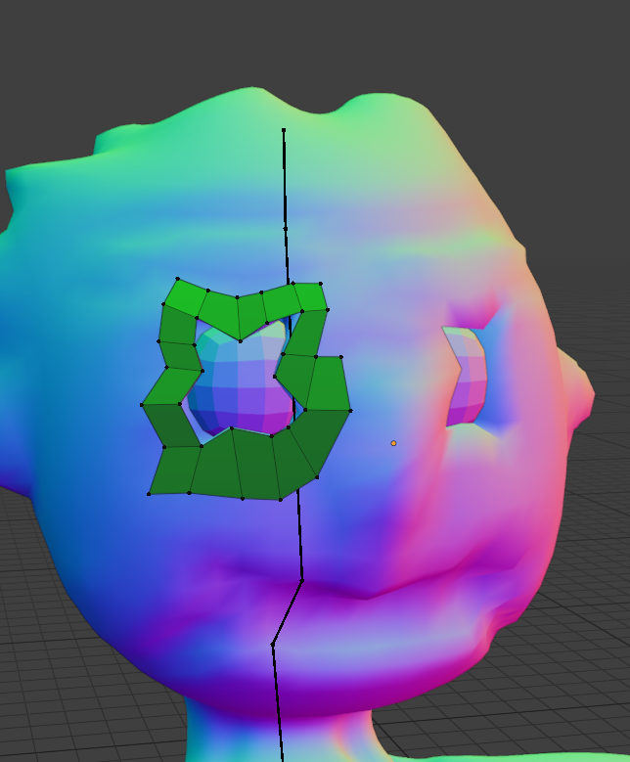
Activity – Retopology of ‘La Creatura’
Download the Blender project ‘La Creatura’ from Session 5 learning content
Using the techniques from video to begin creating a low-poly retopology of the model’s head
Once completed follow steps for creating a normal map from the high-resolution mesh

